Slide 1


High Performance Cluster Computing
Architectures and Systems
Hai Jin
Internet and Cluster Computing Center

Slide 2
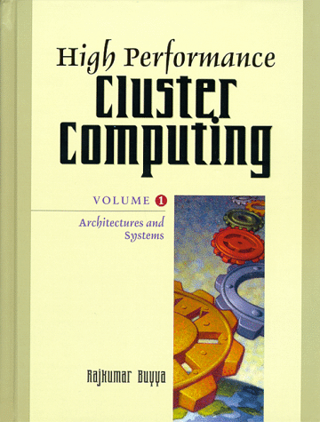
Dependable Clustered Computing
Introduction
Two Worlds Converge
Dependable Concepts
Cluster Architectures
Detecting and Masking Faults
Recovering from Faults
The Practice of Dependable
Clustered Computing

Slide 3
Introduction
Two different areas of computing with slightly different motivations
  High performance (HP)
  High availability (HA)
The clustering model can provide both HA & HP, and also manageability, scalability, & affordability
  To accomplish the dream, cluster software technologies still have to evolve & mature
Clusters
  Poor man’s answer for the parallel high performance computing quest
    Observed in Gordon Bell prize
  Typically homogeneous, tightly coupled, nodes trust each other
    Compare with distributed systems
  As number of h/w components rises, so does the probability of failure
    (Leslie Lamport) “ a distributed system is one in which the failure of a computer you didn’t even know existed can render your own computer unusable”
    Increasing probability of fault occurrence for long-running applications

Slide 4
Failover
In case of failure of a component in the primary system, the critical applications can be transferred to the secondary server, thus avoiding downtime and guaranteeing application’s availability
Inevitably imply a temporary degradation of the service, but without total permanent loss
Fault-tolerant servers, pioneered by Tandem

Slide 5
Two Worlds Converge
Only fault tolerance can enable effective parallel computing by allowing application continuity
Parallelism enables high-availability by providing redundancy

Slide 6
Dependable Parallel Computing (I)
Dependability
  Arose as an issue as soon as clusters started to be used by HP community
Two main reasons
  As systems scale up to hundreds of nodes, the likelihood of a node failure increases proportionally with number of nodes
    caused not only by permanent faults (permanent damage), but mainly by transient ones (due to heating, electromagnetic interference, marginal design, transient SW faults, and power supply disturbances)
  Those faults that statistically don’t cause node failures, but have other insidious effects
    the effect of faults on application running in parallel systems
      a large percentage of faults do not cause nodes to crash, system panics, core dumps, or application to hang
      in many cases, everything goes apparently fine, but in the end, parallel application generate incorrect results

Slide 7
Dependable Parallel Computing (II)
Examples
  ASCI Red : 9000 Intel Pentium Pro (a 263 Gbytes memory machine)
    MTBF : 10 hours for permanent faults, 1-2 hours for transient faults (a node’s MTBF is 10 years)
  ORNL (MPP, not cluster)
    MTBF is 20 hours
  Carnegie Mellon University (400 nodes)
    MTBF is 14 hours

Slide 8
Mission/Business Critical Computing (I)
The demand for HA applications increases
  Electronic commerce, WWW, data warehouse, OLAP, etc.
  the cost of outage is substantial
Development of dependable computing
  Cold-backup
    one of the first protection mechanism for critical applications
    data offline backup
  Hot-backup
    Protect data, not just at a certain time of the day, but on a continuous basis using a mirrored storage system where all data is replicated
    RAID were introduced to protect data integrity
Advanced H/W redundancy system
  Redundancy at all system level to eliminate single point of failure
  Fault tolerant, 99.999 % availability (5 mins downtime per year)

Slide 9
Mission/Business Critical Computing (II)
Combine highly reliable & highly scalable computing solutions with open & affordable components
  Can be done with clusters
  The ability to scale to meet the demands of service growth became a requirement
  High performance joined high-availability as an additional requirement for mission/business critical systems
Clusters intrinsically have the ability to provide HP & scalability
  High availability scalable clusters
Today’s mission/business critical clusters as a combination of the following capabilities
  Availability: one system to failover to another system
  Scalability: increase the number of nodes to handle load increase
  Performance: perform workload distribution
  Manageability: manage a single system
    as a requirement
    clusterware

Slide 10
Dependability Concepts (I)
Faults, Errors, Failures
  Error detection latency
    The time between the first occurrence of the error and the moment when it is detected
    The longer, the most affected the internal state of the system may become
  Fault
    When an error has some phenomenological cause
    Transient
      Re-execution can compensate for a transient fault
    Permanent
      More complex to handle
      Software faults (bugs)
        Bohrbugs
        – bugs are always there again when the program is re-executed
        Heisenbugs
        - in a re-execution, the timing will usually be slightly different, the bug does not happen again

Slide 11
Dependability Concepts (II)
Dependability Attributes
  Reliability
    Probability of that continuous correct operation
  Availability
    A measure of the probability that the system will be providing good service at a given point in time
  MTBF
    The Mean Time Between Failures
  MTTR
    The Mean Time To Repair a failure, & bring the system back to correct service
  Availability can be expressed as MTBF/(MTBF+MTTR)

Slide 12
Dependability Concepts (III)
Dependability Means
  Two ways
    Fault prevention
      Preventing faults from occurring
      Accomplished through conservative design, formal proofs, extensive testing, etc
    Fault tolerance
      Prevent errors from becoming failures
  2 approaches are complementary
  Disaster Tolerance
    Techniques aimed at handling a very particular type of faults, namely site failures caused by fire, floods, sabotages, etc
    Usually implies having redundant hardware at a remote cite

Slide 13
Cluster Architectures (I)
Share-Nothing versus Shared-Storage
  Share-nothing cluster model
    Each node has its own memory & own storage resources
    Allow nodes to access common devices or resources, as long as these resources are owned and managed by a single system at a time
    Avoid the complexity of cache coherency schemes & distributed lock managers
    May eliminate single point of failure within the cluster storage
    Scalable, because of the lack of contention & overhead
      Several strategies aimed at reducing bandwidth overhead
  Shared-Storage
    Both servers share the same storage resource with the consequent need for synchronization between disks accesses to keep data integrity
    Distributed lock managers must be used
    Scalability becomes compromised

Slide 14
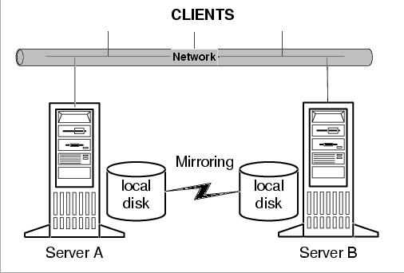
Shared-nothing Clusters

Slide 15
Cluster Architectures (II)
Active/Standby versus Active/Active
  Active/Standby
    Called hot backup
    Primary server where the critical application runs
    Secondary server (hot spare)
      normally in standby mode
      can be a lower performance machine
  Active/Active
    All servers are active & do not sit idle waiting for a fault to occur & take over
    Providing bidirectional-failover
    The price to performance ratio decrease
  N-Way
    Several active servers that back up one another

Slide 16
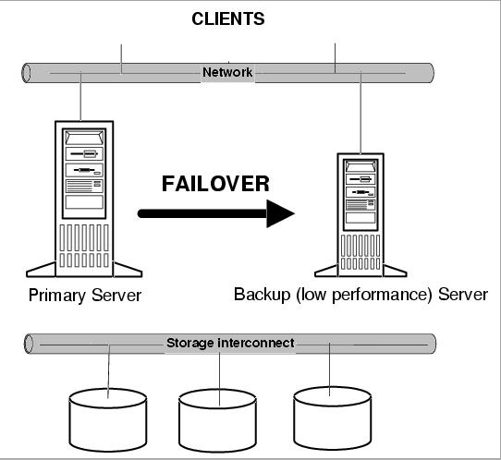
Active/Standby Clusters

Slide 17
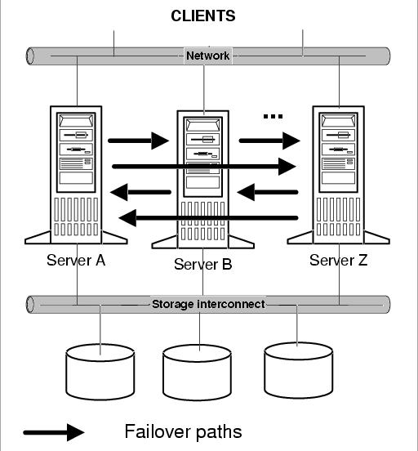
N-Way Clusters

Slide 18
Cluster Architectures (III)
Interconnects
  3 main kinds of interconnects – network, storage, monitoring
    Vital for clusters
  Network interconnect
    Communication channels that provides the network connection between the client systems & the cluster
    Generally Ethernet or fast-Ethernet
  Storage
    Provide the I/O connection between the cluster nodes & disk storage
    SCSI and Fiber Channel
      SCSI is more popular, limit in length (SCSI extender technologies)
      FC-AL permits fast connections - 100Mb/s - & up to 10 Km
  Monitoring
    Additional comm media used for monitoring purposes (heartbeats transfer)
    NCR Lifekeeper
      use both the network & storage interconnect for monitoring
      also have an additional serial link between the servers for that purpose

Slide 19
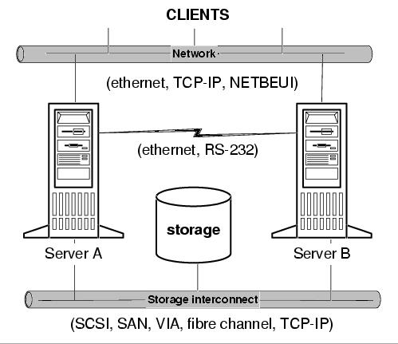
Cluster Interconnects

Slide 20
Cluster Architectures (IV)
VIA
  Virtual Interface (VI) Architecture
  An open industry specification promoted by Intel, Compaq, & Microsoft
  Aim at defining the interface for high performance interconnection of servers and storage devices within a cluster (SAN)
  VI proposes to standardize the network (SAN)
  Define a thin, fast interface that connects software applications directly to the networking hardware while retaining the security & protection of the OS
  VI-SAN
    Specially optimized for high bandwidth & low latency comm

Slide 21
Cluster Architectures (V)
Storage Area Network & Fiber Channel
  SAN
    To eliminate the bandwidth bottlenecks & scalability limitations imposed by previous storage (mainly SCSI bus-based) architectures
    SCSI is based on the concept of a single host transferring data to a single LUN (logical unit) in a serial manner
  FC-AL
    Emerged as the high-speed, serial technology of choice for server-storage connectivity
    The most widely endorsed open standard for the SAN environment
    High bandwidth & scalability,
    Support multiple protocols (SCSI, IP) over a single physical connection
  Modular scalability
    Most important advantages of the SAN approach
    A key to enabling infrastructure for long term growth & manageability

Slide 22
Detecting and Masking Faults (I)
A dependable systems is built upon several layers
  EDM (Error Detection Mechanism)
    Classified according to 2 important characteristics
      Error coverage
        The percentage of errors that are detected
      Detection latency
        The time an error takes to be detected
  Diagnosis layer
    Collect as much info as possible about the location, source & affected parts
    Run diagnosis over the failed system to determine whether the fault is transient or permanent
  Recovery & reconfiguration

Slide 23
Detecting and Masking Faults (II)
Self-Testing
  To detect errors generated by permanent faults
  Consists of executing specific programs that exercise different parts of the system, & validating the output to the expected known results
  Not very effective in detecting transient faults
Processor, Memory, and Buses
  Parity bits - primary memories
  Parity checking circuitry – system buses
  EDAC (error detection & correction) chips
    common in workstation hardware
  Built-in error detection mechanisms
    inside of microprocessors
  Fail to detect problem occurs at a higher level or affects data in subtle ways

Slide 24
Detecting and Masking Faults (III)
Watchdog Hardware Timers
  Provide a simple way of keeping track of proper process functions
  If the timer is not reset before it expires, the process has probably failed in some way
  Provide an indication of possible process failure
  Coverage is limited
    data & results are not checked
  Implemented in SW or HW
Loosing the Software Watchdog
  Software watchdog
    A process that monitors other process(es) for errors
    (simplest) Watch its application until it eventually crashes, the only action it takes is to relaunch the applications
  Monitored process is instrumented to cooperate with the watchdog
  WinFT
    Typical example of a SW watchdog

Slide 25
Detecting and Masking Faults (IV)
Heartbeats
  A periodic notification sent by the application to the watchdog to assert its aliveness
  Consist of an application–initiated “I’m Alive” message, or a request-response scheme (watchdog requests the application to assert its aliveness through “Are you Alive?” message) & wait for acknowledgement
  Can coexist in the same system
    Useless if OS crashes
  Clustering solutions provide several alternate heartbeat paths
    TCP-IP, RS-232, a shared SCSI bus
Idle notification
  Inform the watchdog about periods when the application is idle, or it is not doing any useful work, then the watchdog can perform preventive actions (restarting application)
  Software Rejuvenation
    software gets older, the probability of faults is higher
Error notification
  An application that is encountering errors which it can’t overcome can signal the problem to the watchdog & request recovery actions
  Restart may be enough

Slide 26
Detecting and Masking Faults (V)
Assertions, Consistency Checking, and ABFT
  Consistency checking
    Simple fault detection technique that can be implemented both at the hardware and at the programming level
    Performed by verifying that the intermediate or final results of some operation are reasonable
    At the hardware level, built-in consistency checks for checking addresses, opcodes, and arithmetic operations
  Range check
    Confirm that a computed value is within a valid range
  Algorithm-Based Fault Tolerance (ABFT)
    After executing an algorithm, the application runs a consistency check specific for that algorithm
    Checksum for matrix operations
      Extend the matrices with additional columns

Slide 27
Recovering from Faults (I)
Checkpointing and Rollback
  Checkpointing
    Allow a process to save its state at regular intervals during normal execution so that it can be restored later after a failure to reduce the amount of lost work
    When a fault occurs, the affected process can simply be restarted from the last saved checkpoint (state) rather than from the beginning
    Protect long-running applications against transient faults
    Suitable to recover applications from software errors
  Checkpointing classifications
    Transparency (data to include in the checkpoint)
      Checkpoints can be transparently or automatically inserted at runtime (or by the compiler)
        Save large amounts of data
      Inserted manually by the application programmer
    The checkpointing interval
      The time interval between consecutive checkpoints
      Critical for automatic checkpointing

Slide 28
Recovering from Faults (II)
Transactions
  A group of operations which form a consistent transformation of state
    operations :- DB updates, messages, or external actions
  ACID properties
    Atomicity
      Either all or none of the actions should happen commit or abort
    Consistency
      Each transformation should see a correct picture of the state, even if concurrent transactions are updating the state
    Integrity
      The transaction should be a correct state transformation
    Durability
      Once a transaction commit, all its effects must be preserved, even if there is a failure

Slide 29
Recovering from Faults (III)
Failover and Failback
  Failover process
    The core of the cluster recovery model
    A situation in which the failure of one node causes a switch to an alternative or backup node
    Should be totally automatic and transparent, without the need for administrator intervention or client manual reconnection
    Require a number of resources to be switched over to the new system (switch network identity)
  Takeover
    Used in fault-tolerant systems
    Built with multiple components running in lock-step
  Failback
    Move back the applications/clients to the original server once it is repaired
    Should be automatic & transparent
    Used efficiently for another purpose: maintenance

Slide 30
The Practice of Dependable Clustered Computing (I)
MS Cluster Server
  Wolfpack
    Provide HA over legacy windows applications, as well as provide tools & mechanisms to create cluster-aware applications
    Inherited much of the experience of Tandem in HA
      Tandem provided the Nonstop SW & the ServerNet from Himalaya Servers
  A phased approach
    Phase I :- support 2 node clusters & failover of one node to another
    Phase II :- a multinode share-nothing architecture scalable up to 16 nodes
  Not lock-step/fault-tolerant
    Not support the “moving” of running applications
    Not 99.99999 % available (max of 3-4 sec of downtime per year), but 20 - 30 sec downtime per year
  Structured approach to the cluster paradigm using a set of abstractions
    Resource :- a program or device managed by a cluster
    Resource Group :- a collection of related resources
    Cluster :- a collection of nodes, resources, and groups
  Resource
    The basic building block of the architecture
    3 states
      Offline (exists but is not offering service)
      Online (exists and offers service)
      Failed (not able to offer service)

Slide 31
The Practice of Dependable Clustered Computing (II)
NCR LifeKeeper
  In 1980 NCR began delivering failover products to the telecomm industry
  LifeKeeper in the Unix world in beginning of 90s
  Recently ported to Windows NT
  Multiple fault detection mechanisms
    Heartbeat via SCSI, LAN, & RS 232, event monitoring, & Log monitoring
  3 different configurations
    Active/active, active/standby, & N-way (with N=3)
  Recovery action SW kits for core system components
  Provide a single point of administration & remote administration capabilities

Slide 32
The Practice of Dependable Clustered Computing (III)
Oracle Failsafe and Parallel Server
  Oracle DB options for clustered systems
  The archetype of a cluster solution specially designed for DB systems
  Oracle Failsafe
    Based on MSCS
    Support a max of 2 nodes (due to limitations of MSCS phase I)
    Targeted for workgroup and department servers
  Oracle Parallel Server
    Support a single DB running across multiple nodes in a cluster
    Not require MSCS
    Support more than 2 nodes
    Targeted for enterprise level systems, seeking not only HA but also scalability
    Support Digital Clusters for Windows NT & IBM’s “Phoenix” technology
  Oracle servers
    Support hot-backups, replication, & mirrored solutions

